Slide 1
IS4432 Systems Design
Week 9 – Output Design
Adapted by Janet Yu
115/11/08

Slide 2
Agenda
Output Design
  Basic Principles
  Output to other systems
Group Discussion - RFID
115/11/08

Slide 3
Output Design
Defines the way the system provides information to users or other systems. Can be
  On screen
  On paper
  Via other media
The goal of the output mechanism is to present information to users so they can accurately understand it with the least effort.
115/11/08

Slide 4
Basic Principles
Understand report usage
Manage information load
  All needed information, no more
Minimize bias
115/11/08

Slide 5
Understand Report Usage
Understand how they are used
  Need all information?
    Present in one long scrollable page
  Only used to identify specific items?
  Used as reference?
    Break down into multiple pages on the web
Frequency of report
Distribution of report
Real time or batch
Hardcopy vs softcopy
115/11/08

Slide 6
Manage Information Load
Most managers get too much information, not too little.
A well design report provides all information needed, not all information available.
A common practice is to put the most important information on the top left hand corner of the screen or paper report.
115/11/08

Slide 7
Minimize Bias
In general, entries that appear first in a list may receive more attention than others.
  Sort in alphabetical order? A to Z? Z to A?
  Sort in chronological order? Old to New? New to Old?
  Sort in numeric order? Low to high? High to low?
Pick an order that match the way in which the information is used!
115/11/08

Slide 8
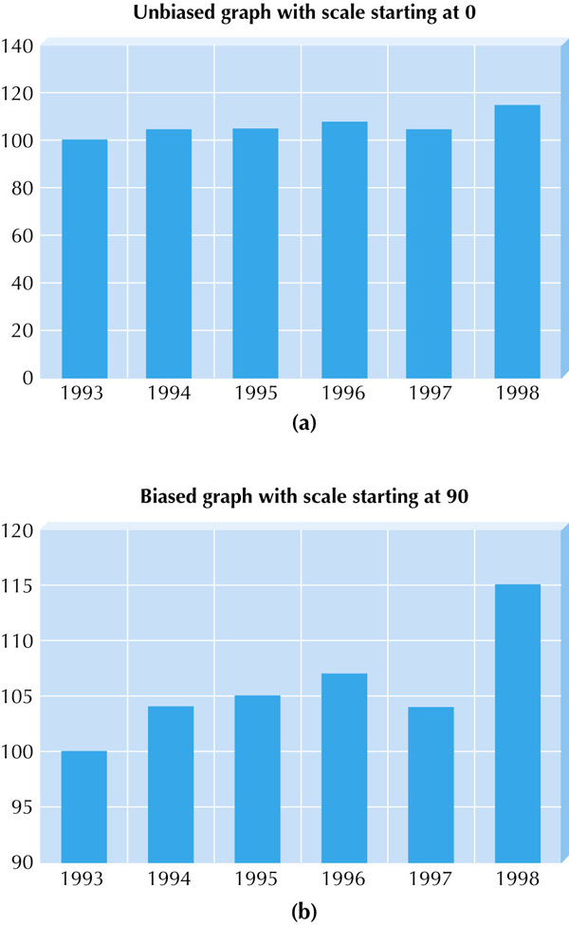
Minimize Bias
The scale on the axes in graphs is particularly subject to bias.
115/11/08

Slide 9
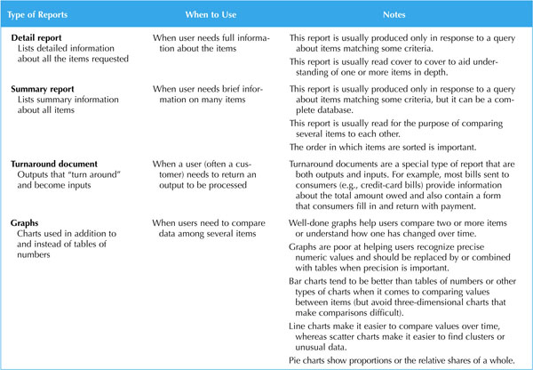
Types of Reports
115/11/08

Slide 10
Types of Reports
Media
  Paper
    Pros - permanent, easy to use, accessible in most situations, highly portable
    Cons – inflexible, expensive, hard to move long distances
  Electronic
115/11/08

Slide 11
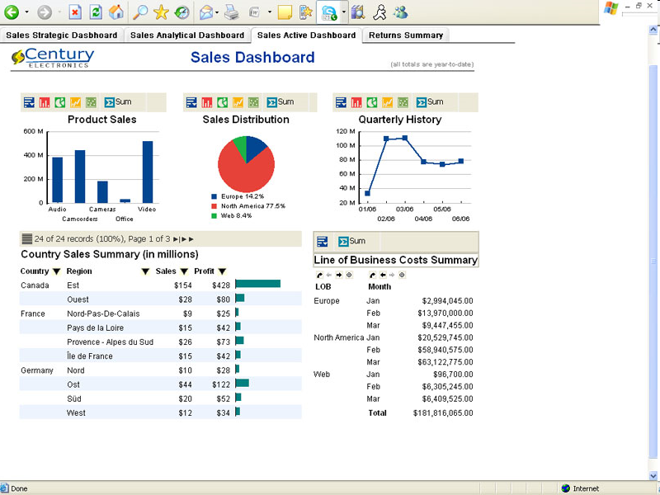
115/11/08

Slide 12
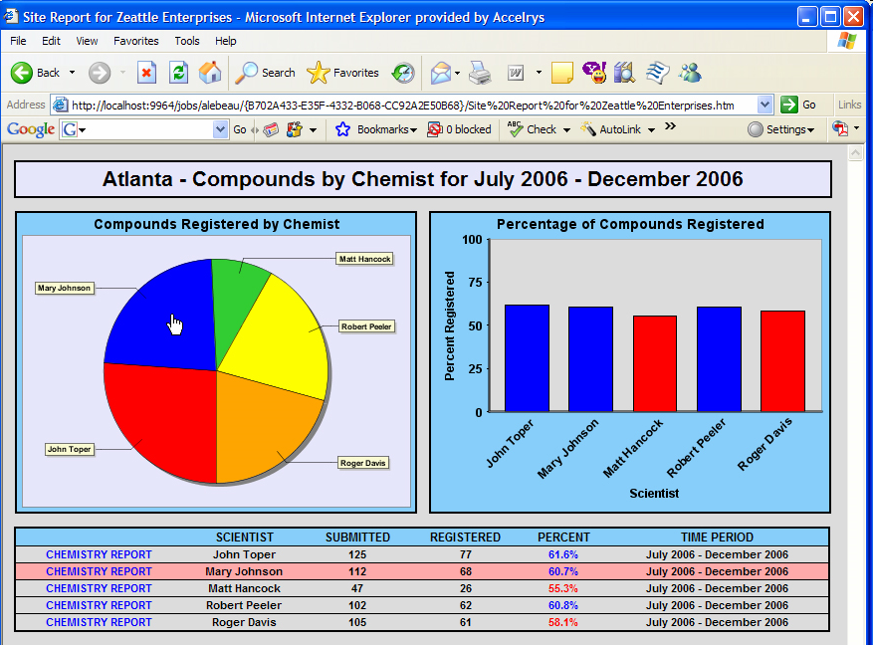
http://accelrys.com/industry/reporting-dashboarding/images/drilldown-report-large.jpg
115/11/08

Slide 13
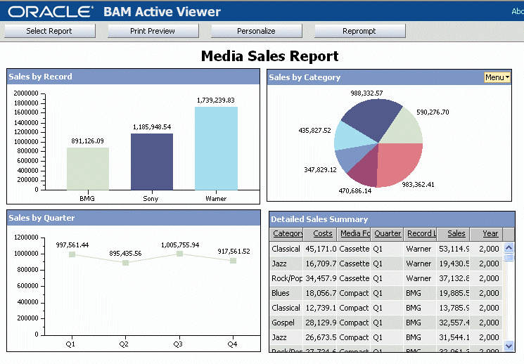
115/11/08

Slide 14
Discussion
Why do we still need paper report?
115/11/08

Slide 15
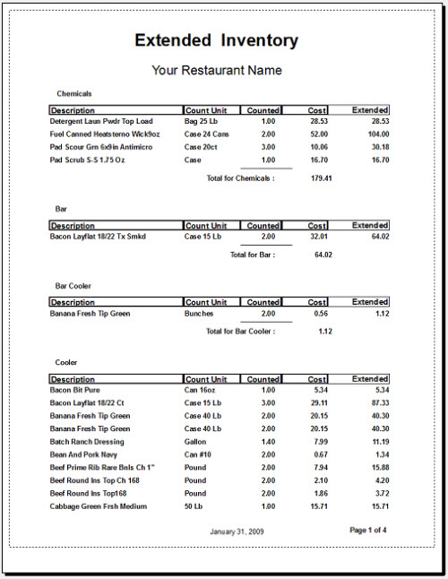
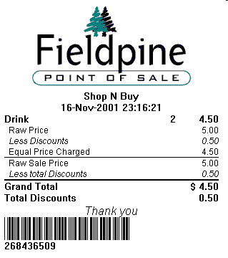
115/11/08

Slide 16
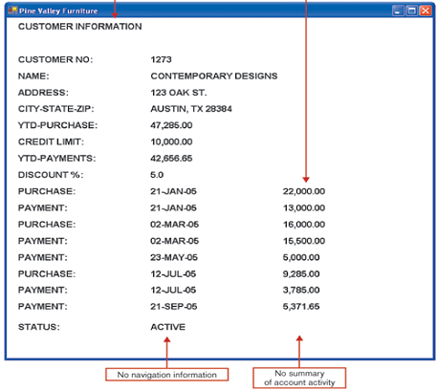
What’s wrong with this report?
115/11/08
Source: Anna Sidorova, University of North Texas

Slide 17
Output to Other Systems
The output mechanism defines the way the system provides information to users or other systems
What about the way to other systems?
115/11/08

Slide 18






Inventory is below reorder level …
Print purchase order
Type in order information
Receive purchase order
Mail / Fax
ERP system – Purchasing Module
Supplier’s ERP system – Sales Module
Purchasing clerk creates a purchase order
115/11/08

Slide 19
Benefits of EDI
Avoids the cost of the creation, recording and storage of paper documents and records.
Automated transfer articulation
Reduces the delays caused by postal paper chains.
More secure than paper
Acknowledgements from receiving institution
Avoids the need to re-key data and therefore saves time and reduces errors.
115/11/08

Slide 20
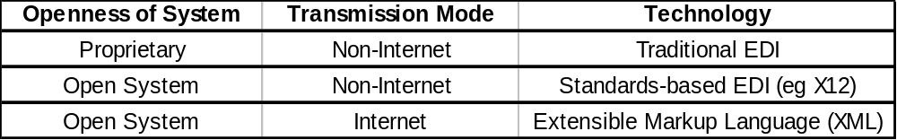
Electronic Data Interchange
The transfer of structured data, by agreed message standards, from one computer system to another (can be from one trading partner to another trading partner) without human intervention but by electronic means.
Message Standards
  Only mutually agreed by two parties
  American Standard … x12
  European Standard … EDIFACT
  http://en.wikipedia.org/wiki/X12_EDIFACT_Mapping
115/11/08

Slide 21
Extensible Markup Language
XML (Extensible Markup Language) is a set of rules for encoding documents electronically
You can design your own tags - extensible
115/11/08

Slide 22
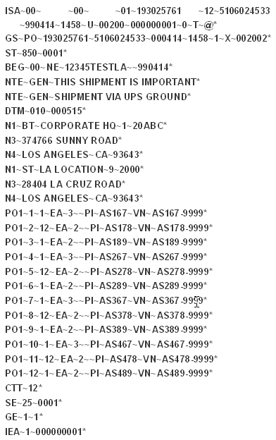
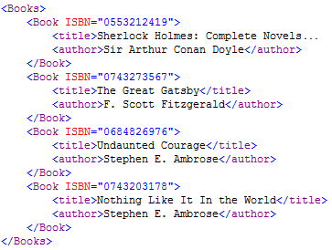
XML Vs X12
Left: XML
Right: X12
115/11/08

Slide 23
EDI vs XML
EDI | XML
Standardized rigid format | Easy to learn
High level of security with dedicated EDI server and Point-to-point integration | Transacts over existing internet
Very large file size and thus less efficient transmission | Exchanges large amounts of data in small file size
Man and machine decipherable (easy to read by humans; not as secure) | Machine decipherable (difficult for a person to read)
115/11/08

